Slide 1
Software analysis and design
Module 1: Best practices of Software Engineering

Slide 2
Objectives: Best Practices
Identify symptoms of software development problems
Explain the Best Practices
Present the Rational Unified Process (RUP) within the context of the Best Practices.

Slide 3
Symptoms of Software
Development Problems
User or business needs not met
Requirements not addressed
Modules not integrating
Difficulties with maintenance
Late discovery of flaws
Poor quality of end-user experience
Poor performance under load
No coordinated team effort
Build-and-release issues

Slide 4




Trace Symptoms to Root Causes
Symptoms
Root Causes Best Practices
Insufficient requirements Develop Iteratively
Needs not met Requirements churn
Ambiguous communications
Ambiguous communications
Modules do not fit
Brittle architectures
Manage Requirements
Modules don’t fit
Hard to maintain Late discovery Poor quality
Poor performance
Colliding developers Build-and-release
Overwhelming complexity
Undetected inconsistencies
Use Component Architectures
Undetected inconsistencies
Poor testing Subjective assessment Waterfall development Uncontrolled change Insufficient automation
Model Visually (UML)
Continuously Verify Quality
Manage Change

Slide 5




Best Practices Reinforce Each Other
Best Practices
d
Manage Requirements Use Component Architectures
Model Visually (UML)
Continuously Verify Quality Manage Change
Ensures users are involved as requirements evolve
Validates architectural decisions early on
Addresses complexity of design/implementation incrementally
Measures quality early and often Evolves baselines incrementally

Slide 6

Develop Iteratively
Iterative development produces an executable
Requirements
Analysis & Design
2. Planning
1. Initial Planning
5. Implementation
Management Environment (on-going)
6. Test
8. Evaluation
7. Deployment
Each iteration results in an executable release

Slide 7
Managing Requirements
Ensures that you
solve the right problem
build the right system
by taking a systematic approach to
eliciting
organizing
documenting
managing
the changing requirements of a software application.

Slide 8
Use Component Architectures
Software architecture needs to be:
Component-based | Resilient
Reuse or customize components Select from commercially available components Evolve existing software incrementally | Meets current and future requirements Improves extensibility Enables reuse Encapsulates system dependencies

Slide 9
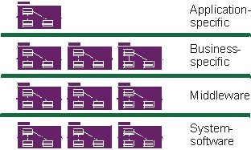
Purpose of a Component-Based
Architecture
Basis for reuse
Component reuse
Architecture reuse
Basis for project management
Planning
Staffing
Delivery
Intellectual control
Manage complexity
Maintain integrity

Slide 10
Model Visually (UML)
Captures structure and behavior
Shows how system elements fit together
Keeps design and implementation consistent
Hides or exposes details as appropriate
Promotes unambiguous communication
– The UML provides one language for all practitioners.

Slide 11
Visual Modeling with the Unified
Modeling Language
Static Diagrams
Class Diagrams
Use-Case Diagrams
Sequence Diagrams
Object Diagrams
Communication Diagrams
Component Diagrams
Models
State Machine Diagrams
Deployment Diagrams
Activity Diagrams

Slide 12

Continuously Verify Quality
Software problems are 100 to 1000 times more costly
to find and repair after deployment
Cost to Repair Software
Cost of Lost Opportunities
Cost of Lost Customers
Cost
Inception
Elaboration
Construction
Transition

Slide 13
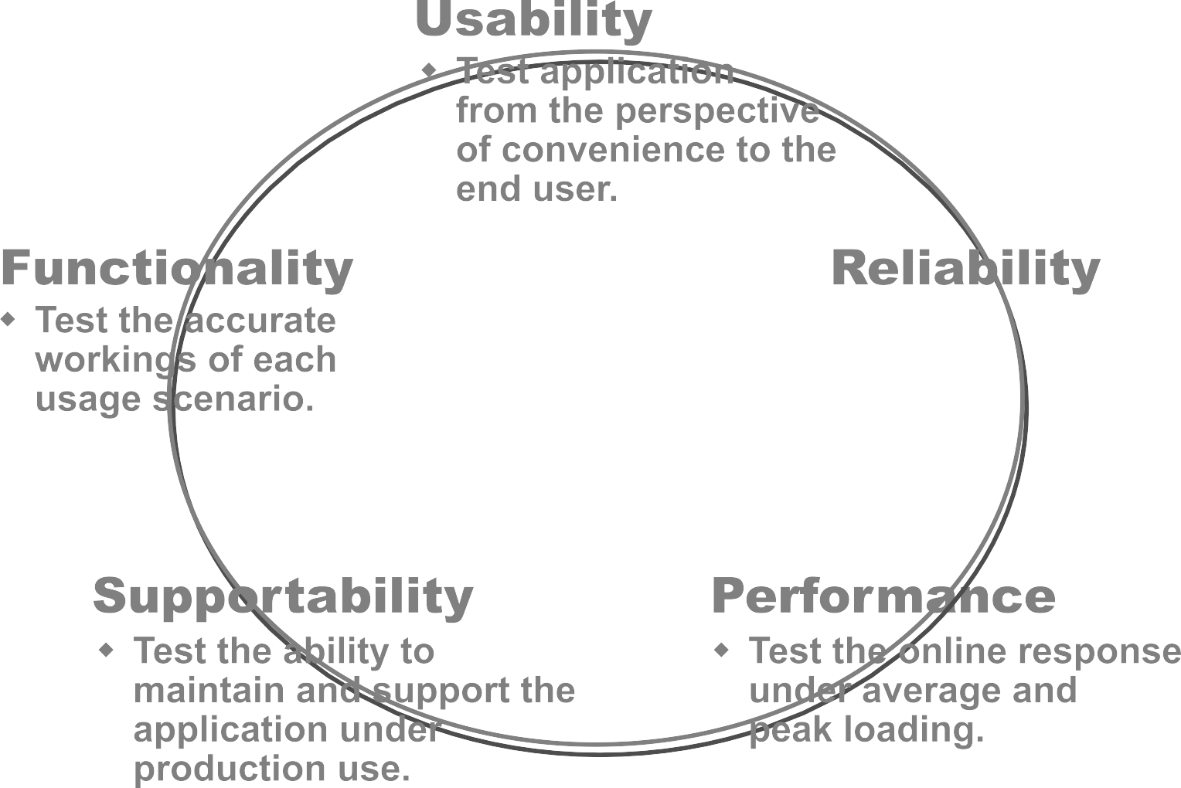

Testing Dimensions of Quality
Usability
Test application from the perspective
of convenience to the end user.
Reliability
Functionality
Test the accurate workings of each usage scenario.
Supportability
Test the ability to maintain and support the application under production use.
Performance
Test the online response under average and
peak loading.

Slide 14



Manage Change
To avoid confusion, have:
Secure workspaces for each developer
Automated integration/build management
Parallel development
Workspace Management
Process Integration
Parallel Development
Build Management

Slide 15
Manage Change (continued)
Unified Change Management (UCM) involves:
Management across the lifecycle
System
Project management
Activity-based management
Tasks
Defects
Enhancements
Progress tracking
Charts
Reports

Slide 16


Rational Unified Process
Implements Best Practices
Best Practices
Process Made Practical
Develop Iteratively Manage Requirements
Use Component Architectures
Model Visually (UML) Continuously Verify Quality Manage Change

Slide 17
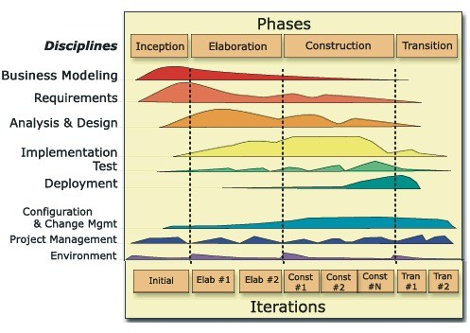
Achieving Best Practices
Iterative approach
Guidance for activities and artifacts
Process focus on architecture
Use cases that drive design and implementation
Models that abstract the system

Slide 18
A Team-Based Definition of
Process
A process defines Who is doing What, When, and
How, in order to reach a certain goal.
Software Engineering Process
New or changed requirements
New or changed system

Slide 19
Process Structure - Lifecycle
Phases
The Rational Unified Process has four phases:
Inception – Define the scope of the project
Elaboration – Plan the project; specify features and baseline architecture
Construction – Build the product
Transition – Transition the product into the end-user community
Inception | Elaboration | Construction | Transition
Time

Slide 20

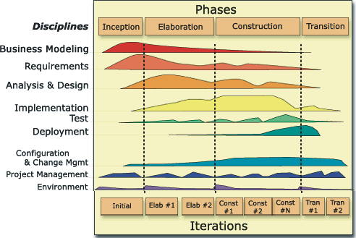

Bringing It All Together: The Iterative Approach
In an iteration, you walk through all disciplines.
Disciplines group activities logically.

Slide 21
Summary
Best Practices guide software engineering by addressing root causes.
Best Practices reinforce each other.
Process guides a team on who does what, when, and how.
The Rational Unified Process is a means of achieving Best Practices.

